Slide 1



Bioremediation of Arsenic Contaminated Water
Sarah Moore
Lucia Rodriguez-Freire, Dr. James Field, and Dr. Reyes Sierra
Department of Chemical and Environmental Engineering
The University of Arizona
23rd Annual Arizona Space Grant Consortium Symposium
The University of Arizona, Tucson, AZ
April 12th, 2014

Slide 2
Outline
Arsenic Background and Theory
Project Objectives
Experimental Methods
Results
Conclusions
Continued Work

Slide 3
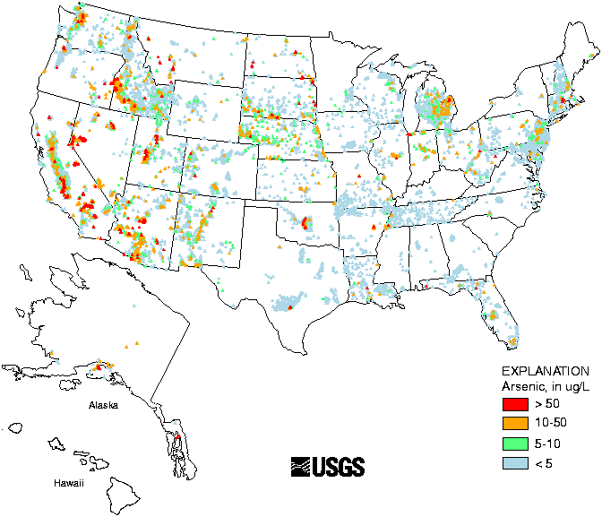
Arsenic Background
Arsenic (As) is an important water contaminant
  Toxicity
  Carcinogenicity
  Widespread occurrence
  Natural and Industrial
Source: http://www.water-research.net/arsenic.htm

Slide 4


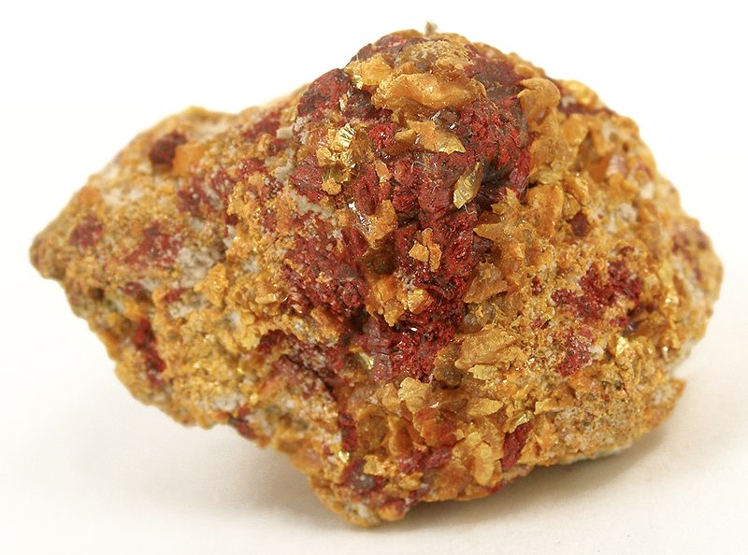

The Arsenic Cycle
As^{V}
⬆⬇
As^{III}
⬇
Trimethylarsine
Water
Arsenic occurs in several forms: Dissolved cations (As^{III} and As^{V}), elemental As, organic As, arsenic sulfide minerals
Microorganisms play an important role in the arsenic cycle

Slide 5
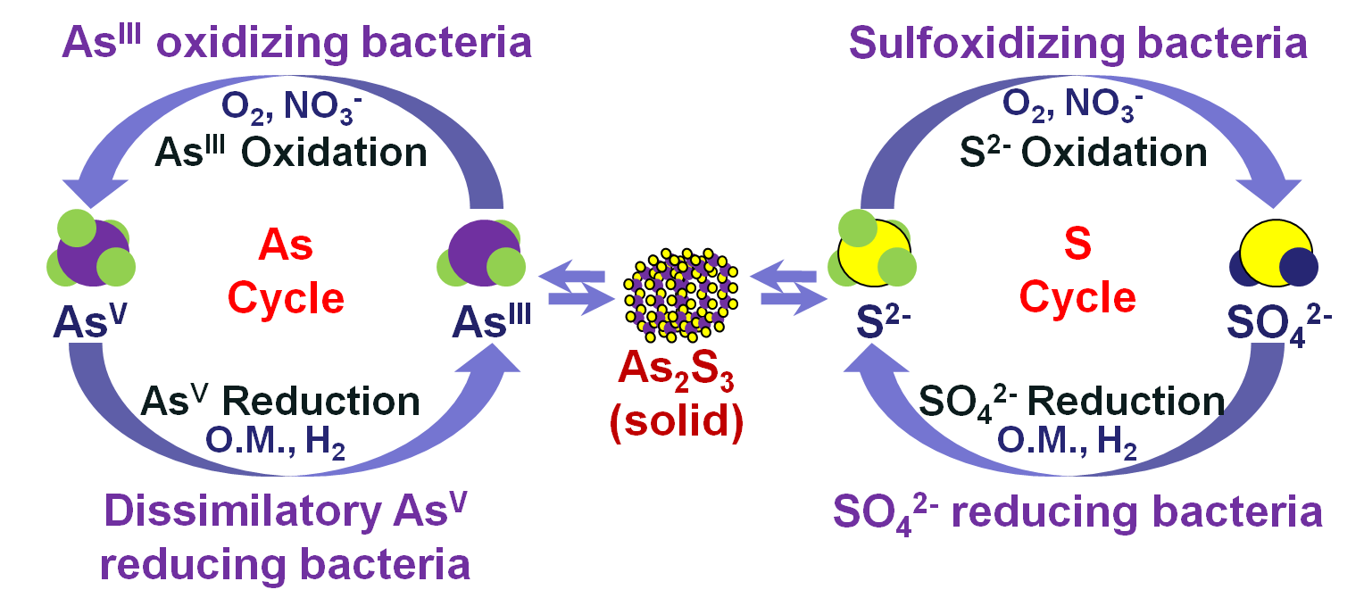
Arsenic Sulfide Biomineralization
Source: Lucia Rodriguez-Freire

Slide 6
Objectives
Investigate the possibility of bioremediation of arsenic contaminated water
Process of anaerobic biomineralization
Explore implementation of continuous biological reactors

Slide 7
Methods
Complete Treatment: Biomineralization
Control:
No Biomineralization
S²⁻, As^{III} (reduced amount), byproducts
As^{III}, byproducts
As^{V} ➔As^{III}
SO₄²⁻➔ S²⁻
As^{III}+ S²⁻
⬇
As₂S₃ (Solid)
As^{V} ➔As^{III}
As^{V}, SO₄²⁻, food
As^{V}, food,
NO SO₄²⁻

Slide 8
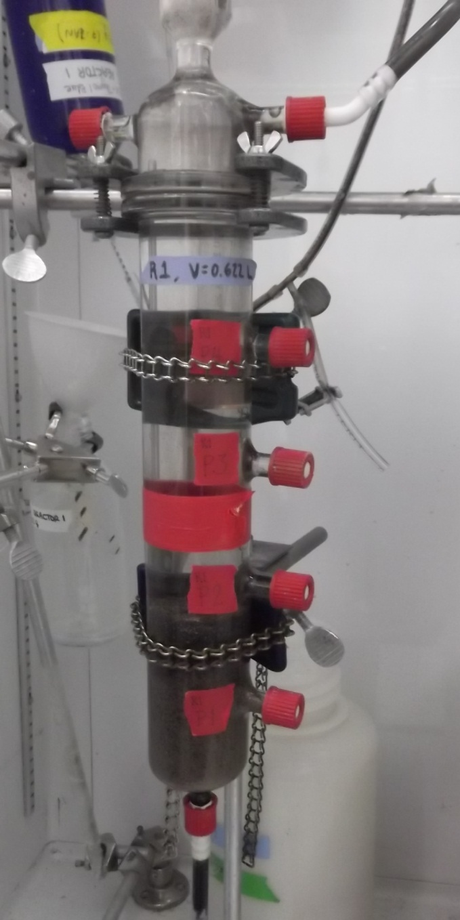
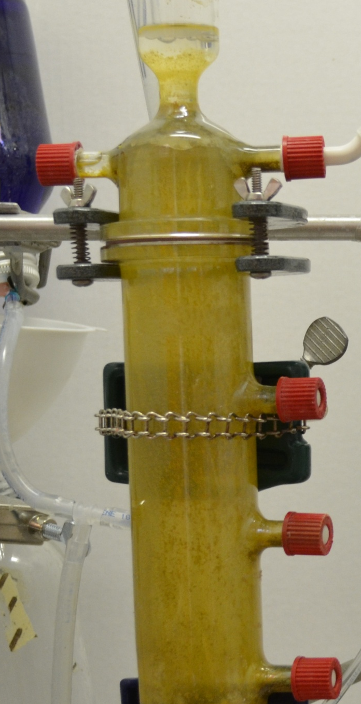
Results
Day 0
Day 154

Slide 9
Electron Microscope Image
Source: University Spectroscopy and Imaging Facility (USIF)

Slide 10
Arsenic Concentration: Complete Treatment

Slide 11
Arsenic Concentration: Control

Slide 12
Percent Arsenic Removal

Slide 13
Conclusions
Arsenic-sulfide minerals can be formed in anaerobic continuous bioreactors
An average of 92% of the total As was removed in the complete treatment
Arsenic biomineralization can be used to remediate arsenic contaminated water

Slide 14
Continued Work
Long term mineral stability experiments
  At pH = 6.5, less than 1% of mineral dissolved
  At pH = 7.5, significant amount of mineral dissolved
Design of bioremediation system that implements biomineralization
  In situ
  Pump and treat
  Permeable Reactive Barrier

Slide 15
Thank You!
Special thanks to my mentors, Lucia Rodriguez-Freire, Dr. James Field, and Dr. Reyes Sierra, the UA Chemical and Environmental Engineering Department, University Spectroscopy and Imaging Facility (USIF), Robert Root (UA) and Stanford Synchrotron Radiation Laboratory (SSRL), NASA and the Arizona Space Grant Consortium.

Slide 16
Extra Slides for Questions

Slide 17
Reactor Specifics
Complete Treatment Influent
  1 mM As^{V}
  1.5 mM SO₄²⁻
  4.5 mM Ethanol
  Minerals
Control Influent
  1 mM As^{V}
  4.5 mM Ethanol
  Minerals
Analytical Techniques
  Ethanol and Acetate: Gas Chromatography
  SO₄²⁻ and As^{V}: Ion Chromatography
  Sulfide: Colorimetric Methods
  Total As: Inductively Coupled Plasma

Slide 18
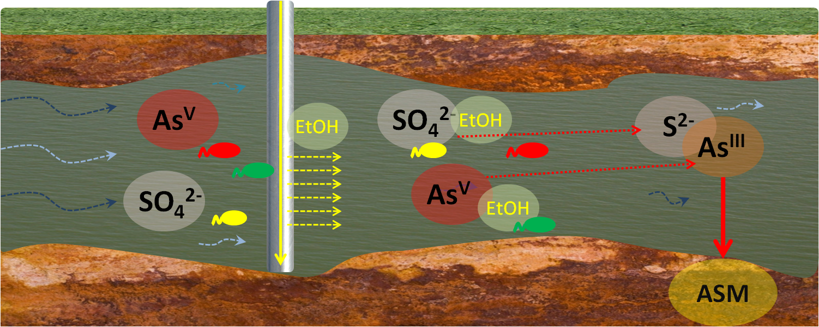
In Situ Bioremediation
Source: Lucia Rodriguez-Freire

Slide 19
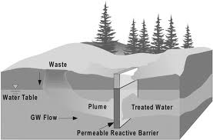
Permeable Reactive Barrier Bioremediation
Source: http://eg.geoscienceworld.org/content/8/4/258/F1.expansion.html

